Slide 1
DFW Q2 FAIR Chapter meeting
Josh Marker

Slide 2
Disclaimer:
All opinions expressed herein are mine and do not represent my employer.
Any perceived recommendations are my opinion and do not constitute professional or consulting services nor represent my employer.

Slide 3
AGENDA
Goals of this talk
Basics of FAIR
Data Sources
Data Gathering
Model the Data
Validate
What next?
Resources

Slide 4
Goals of this talk:
Get you started with Cyber Risk Quantification
No cost
No special software
High Quality, freely available data

Slide 5
Basics of FAIR
Scenario-based (scoping)
Threat
Asset
Effect

Slide 6
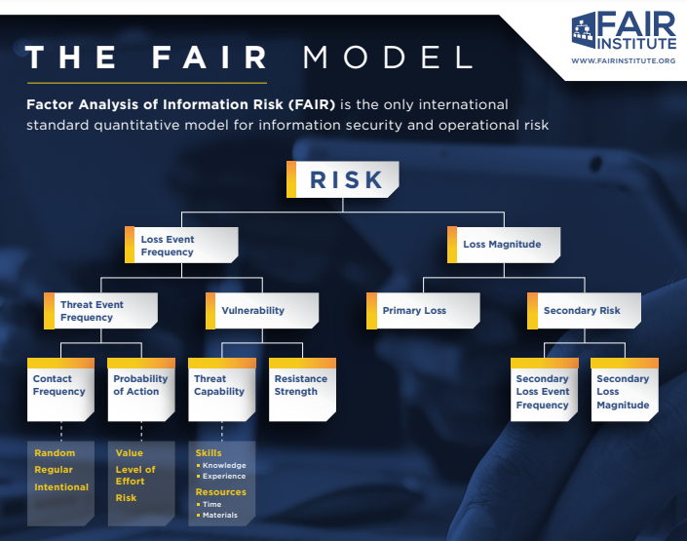
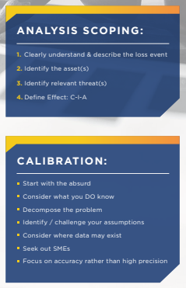
Basics of FAIR

Slide 7
FAIR Scenarios
Σ
[THREAT ACTOR] targets [ASSET] causing [EFFECT]
Cyber criminals target web application 1 causing confidentiality event.
Cyber criminals target web application 2 causing confidentiality event.
State-affiliated hackers (APT) target web application 3 causing confidentiality event.
State-affiliated hackers (APT) target our organization causing confidentiality event.
.
.
.
= LEF (breach)

Slide 8
FAIR Scenarios
[THREAT ACTOR] targets [ASSET] causing [EFFECT]
Which scenarios should we analyze?

Slide 9
Data Sources

Slide 10
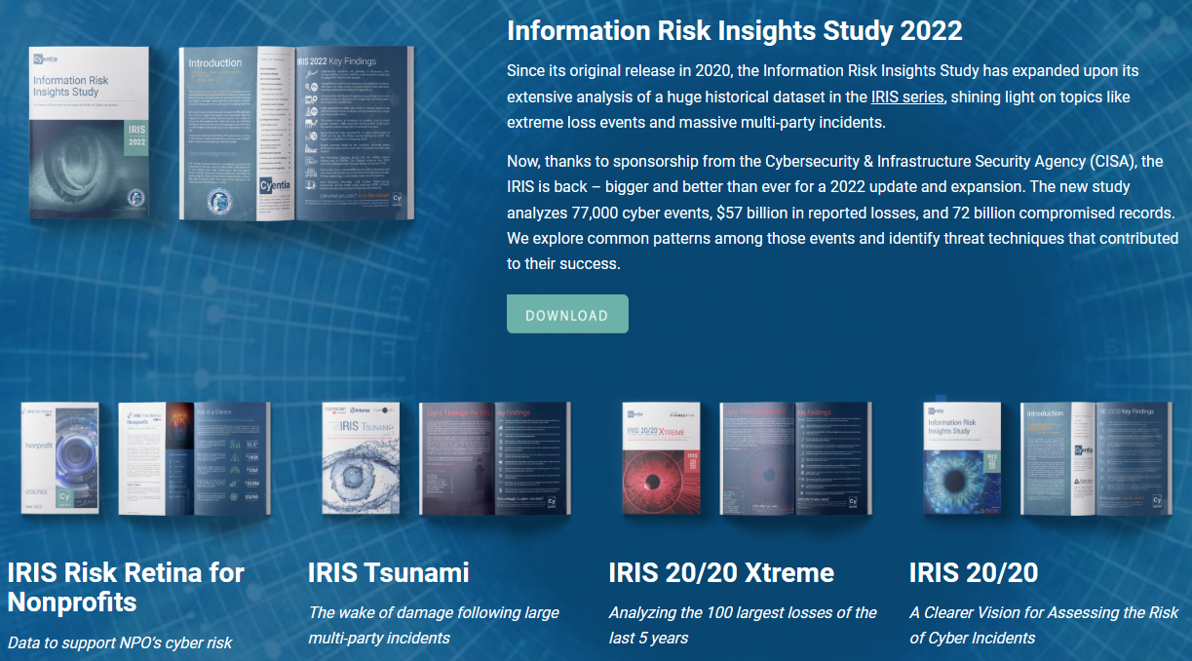
Data Sources
Cyentia Information Risk Insights Study (“IRIS”)
https://www.cyentia.com/iris/

Slide 11
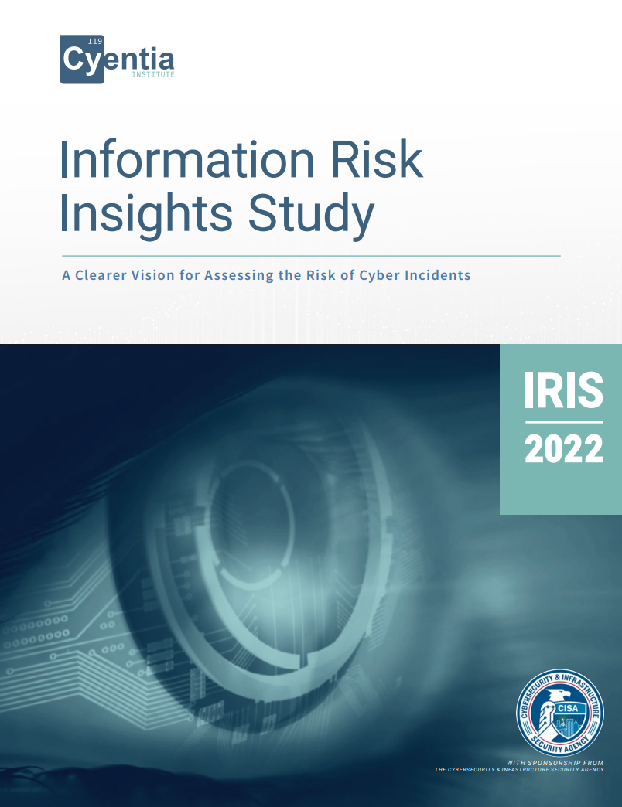
Data Sources
Cyentia Information Risk Insights Study (“IRIS”)
https://www.cyentia.com/wp-content/uploads/IRIS-2022_Cyentia.pdf
IRIS-2022

Slide 12
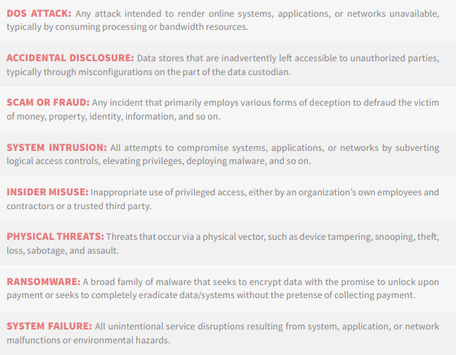
Data Sources
Which scenarios should we analyze?
IRIS Incident Patterns
IRIS-2022

Slide 13
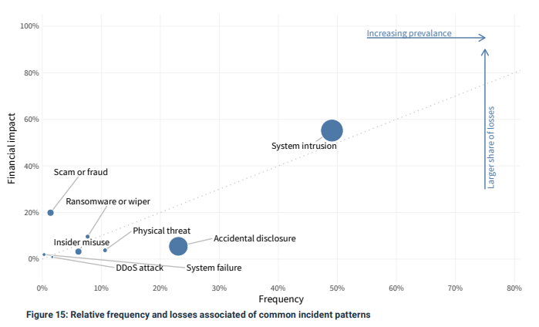
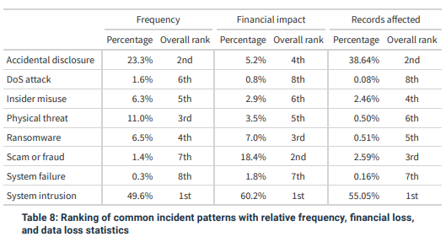
Data Sources
Which scenarios should we analyze?
IRIS Incident Patterns
IRIS-2022

Slide 14
Data Gathering
Loss Event Frequency or Probability
Adjustments by pattern & industry
Loss Magnitude
Adjustments by pattern & industry

Slide 15
Now that we’ve selected our scenarios, what are the LEF values we use? How do we account for the scenario (incident pattern) and the industry?
Loss Event Frequency (or Probability)

Slide 16
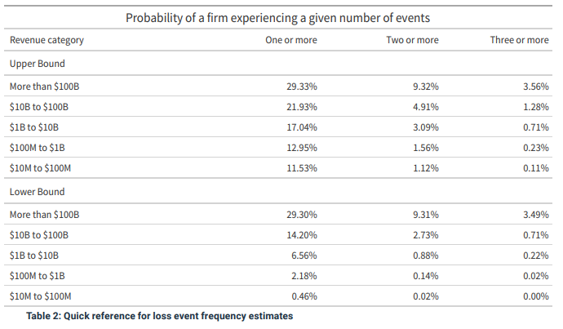
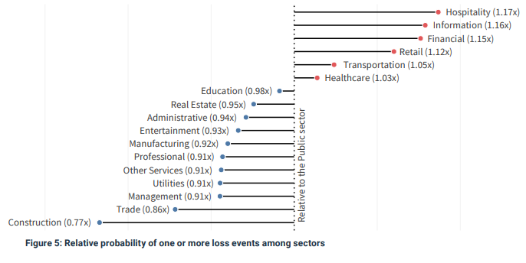
Suppose we’re modeling as if we work for a company with $500M in annual revenue in the financial services industry.
Loss Event Frequency (or Probability)
IRIS-2022
For a financial services company with $500M in annual revenue, there is a 2.51% to 14.89% chance to experience one or more publicly reported events annually (based on data from 2012 to 2021). (This is for all event types.)
For a company with $500M in annual revenue, there is a 2.18% to 12.95% chance to experience one or more publicly reported events annually (based on data from 2012 to 2021).

Slide 17
Now let’s try to determine the Loss Event Frequency by incident pattern, given that we know the overall LEF.
Loss Event Frequency (or Probability)
IRIS-2022
If 49.6% of incidents (by frequency) are system intrusion, then of our 2.51% to 14.89%
chance to have one or more events per year, we will have between
1.24% and 7.39% chance of one or more system intrusions per year.
If 23.3% of incidents (by frequency) are accidental disclosure, then of our 2.51% to 14.89%
chance to have one or more events per year, we will have between
0.58% and 3.47% chance of one or more accidental disclosure per year.
If 6.5% of incidents (by frequency) are ransomware, then of our 2.51% to 14.89%
chance to have one or more events per year, we will have between
0.16% and 0.97% chance of one or more ransomware events per year.
For a financial services company with $500M in annual revenue, there is a 2.51% to 14.89% chance to experience one or more publicly reported events annually (based on data from 2012 to 2021). (This is for all event types.)
If 1.4% of incidents (by frequency) are scam or fraud, then of our 2.51% to 14.89%
chance to have one or more events per year, we will have between
0.04% and 0.21% chance of one or more scam or fraud events per year.

Slide 18
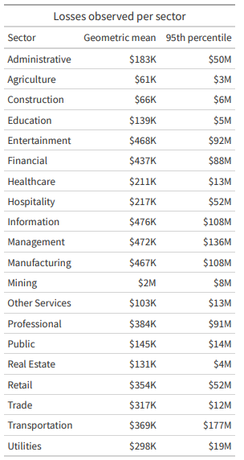
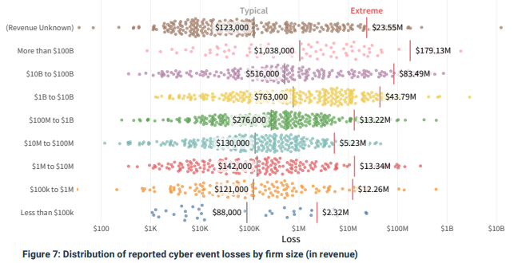

What is my average loss magnitude?
Loss Magnitude
IRIS-2022
Recommendation:
Typical: average (mean) of the typical losses by industry & size.
Extreme: use larger of the 2 or average (mean) of extreme losses by industry & size.
Typical: ($437k + $276k) / 2 = $356.5k
Extreme: $88M or $50.6M

Slide 19
Now that we have loss event frequency by incident pattern, and typical/extreme loss magnitude for our organization type & size, we need to find out loss magnitude by incident pattern. Question: do certain incident patterns cause more (or less) loss than the average?
Loss Magnitude
IRIS-2022
Hint:

Slide 20
Loss Magnitude
Now that we have loss event frequency by incident pattern, and typical/extreme loss magnitude for our organization type & size, we need to find out loss magnitude by incident pattern. Question: do certain incident patterns cause more (or less) loss than the average?
IRIS-2022
If system intrusions are 49.6% of incidents (by frequency) but are 60.2% of losses (by
financial impact), what can we say about the loss from system intrusions on average?
Losses from system intrusion are about
60.2%/49.6% = 1.21 times the average loss.
If accidental disclosure are 23.3% of incidents (by frequency) but are 5.2% of losses (by
financial impact), what can we say about the loss from accidental disclosure on average?
Losses from accidental disclosure are about
5.2%/23.3% = 0.22 times times the average loss.
If ransomware are 6.5% of incidents (by frequency) but are 7% of losses (by
financial impact), what can we say about the loss from ransomware events on average?
Losses from ransomware events are about
7%/6.5% = 1.08 times the average loss.
If scam or fraud are 1.4% of incidents (by frequency) but are 18.4% of losses (by
financial impact), what can we say about the loss from scam or fraud on average?
Losses from scam or fraud are about
18.4%/1.4% = 13.1 times the average loss.

Slide 21
Loss Magnitude
Now that we have loss event frequency by incident pattern, and typical/extreme loss magnitude for our organization type & size, we need to find out loss magnitude by incident pattern. Question: do certain incident patterns cause more (or less) loss than the average?
IRIS-2022
Losses from system intrusion are about 1.21 times the average loss.
Typical Loss Magnitude: $431.4k
Extreme Loss Magnitude: $61.24M
Then using our typical and extreme values for our industry & size:
Typical: $356.5k
Extreme: $50.6M
Losses from accidental disclosure are about 0.22 times the average loss.
Typical Loss Magnitude: $78.4k
Extreme Loss Magnitude: $11.13M
Losses from ransomware events are about 1.08 times the average loss.
Typical Loss Magnitude: $385k
Extreme Loss Magnitude: $54.65M
Losses from scam or fraud are about 13.1 times the average loss.
Typical Loss Magnitude: $4.7M
Extreme Loss Magnitude: $662.9M

Slide 22
2) Model the Data

Slide 23
Validate
We’ve created multiple scenarios for an organization in your reference class.
We’ve used these to create an aggregated risk profile (1 loss exceedance curve).
Our example reference class is the companies that are financial organization with
annual revenue between $100M and $1B.
The results of this analysis pertain to any company in your reference class.
You are a member of this reference class, but this does not mean that this is the
risk for your organization. It means this is the risk for any randomly selected
Company in your reference class (of which, your company is one).

Slide 24
What Next?
A Few IDeas
Extend data tables (use more than 1,000 simulations per scenario, recommend at least 10,000)
Model all the incident patterns (the 8 from Cyentia’s IRIS)
Compare to other models
FREE
FAIR U (https://www.fairinstitute.org/fair-u
SIPmath (https://publications.opengroup.org/i181)
HTMA (http://www.howtomeasureanything.com/cybersecurity/)
Use different distributions (PERT, Triangle, Poisson/Lognormal)
Non-Free
Get additional data
From outside your organization (Cyentia, Verizon DBIR, Advisen, NetDiligence, etc.)
From inside your organization
Determine how your organization is different from your reference class
How is the threat environment compared to your reference class?
How is your control environment compared to your reference class?
How to Use this:
What control additions or improvements are needed and make most economic sense?
We can express risk quantitatively → how does that compare to what our company wants?
Risk Appetite / Tolerance / Capacity
Remember: this is a starting place
Show’s you how to structure and what is reasonable starting data
Now improve iteratively

Slide 25
Resources
1) FAIR Institute (www.fairinstitute.org)
2) FAIR on a page (link)
3) Verizon DBIR (https://www.verizon.com/business/resources/reports/dbir/2023/introduction/
Free, but behind registration wall
4) Cyentia IRIS Reports (https://www.cyentia.com/iris/)
5) How To Measure Anything (http://www.howtomeasureanything.com/cybersecurity/)
6) FAIR U (https://www.fairinstitute.org/fair-u)
7) SIPmath (https://publications.opengroup.org/i181)
8) Modified PERT distribution (https://riskwiki.vosesoftware.com/ModifiedPERTdistribution.php)
9) OpenFAIR OR-A (https://pubs.opengroup.org/security/o-ra)
10) OpenFAIR OR-T (https://pubs.opengroup.org/security/o-rt/)
11) OpenFAIR Mathematics (https://publications.opengroup.org/security-library/g224)
12) HDR PRNG Paper (https://hubbardresearch.com/wp-content/uploads/2020/07/Final-Hubbard-WSC-PRNG-version-dwh-8-21-2019.pdf)
13) Github (https://github.com/josh-marker/risk-quant)

Slide 26
THANK YOU
Josh Marker
Josh.L.Marker@gmail.com
https://www.linkedin.com/in/joshm314/

